Slide 1
Distributed Arithmetic: Implementations and Applications
A Tutorial

Slide 2
Distributed Arithmetic (DA)
[Peled and Liu,1974]
An efficient technique for calculation of sum of products or vector dot product or inner product or multiply and accumulate (MAC)
MAC operation is very common in all Digital Signal Processing Algorithms

Slide 3
So Why Use DA?
The advantages of DA are best exploited in data-path circuit designing
Area savings from using DA can be up to 80% and seldom less than 50% in digital signal processing hardware designs
An old technique that has been revived by the wide spread use of Field Programmable Gate Arrays (FPGAs) for Digital Signal Processing (DSP)
DA efficiently implements the MAC using basic building blocks (Look Up Tables) in FPGAs

Slide 4

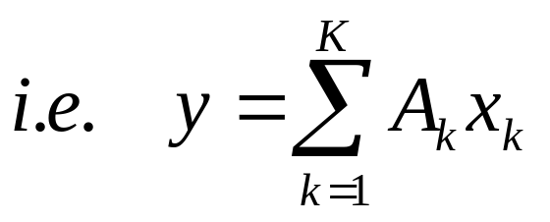
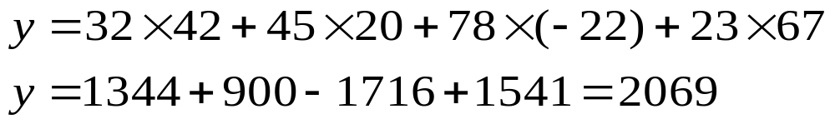
An Illustration of MAC Operation
The following expression represents a multiply and accumulate operation
A numerical example

Slide 5
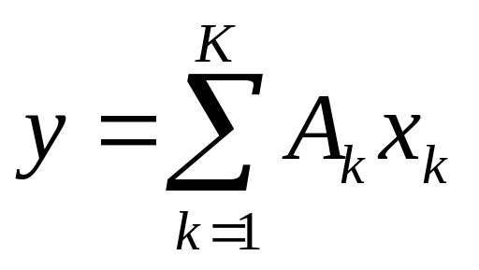
A Few Points about the MAC
Consider this
Note a few points
A=[A₁, A₂,…, A_{K}] is a matrix of “constant” values
x=[x₁, x₂,…, x_{K}] is matrix of input “variables”
Each A_{k} is of M-bits
Each x_{k} is of N-bits
y should be able large enough to accommodate the result

Slide 6
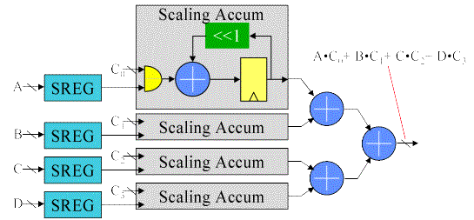
A Possible Hardware (NOT DA Yet!!!)
Let,
Shift right
Registers to hold sum of partial products
Multi-bit AND gate
Adder/Subtractor
Each scaling accumulator calculates A_{i} X x_{i}
Shift registers

Slide 7
How does DA work?
The “basic” DA technique is bit-serial in nature
DA is basically a bit-level rearrangement of the multiply and accumulate operation
DA hides the explicit multiplications by ROM look-ups → an efficient technique to implement on Field Programmable Gate Arrays (FPGAs)

Slide 8
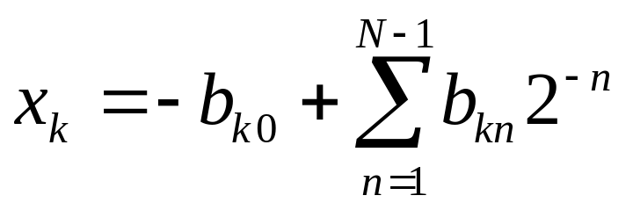
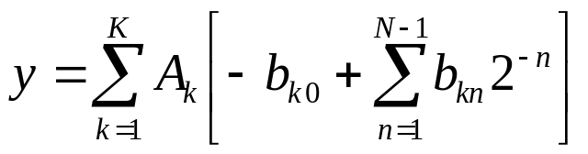
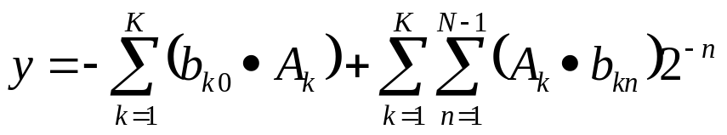
Moving Closer to Distributed Arithmetic
…(1)
Consider once again
  a. Let x_{k} be a N-bits scaled two’s complement number i.e.
  | x_{k} | < 1
  x_{k} : {b_{k0}, b_{k1}, b_{k2}……, b_{k(N-1)} }
    where b_{k0} is the sign bit
  b. We can express x_{k} as
  c. Substituting (2) in (1),
…(2)
…(3)

Slide 9
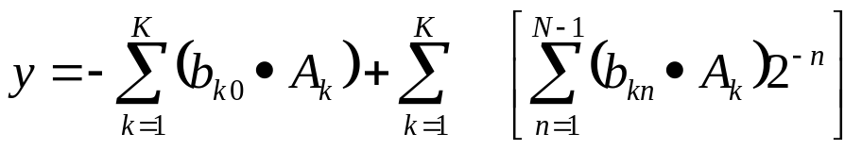
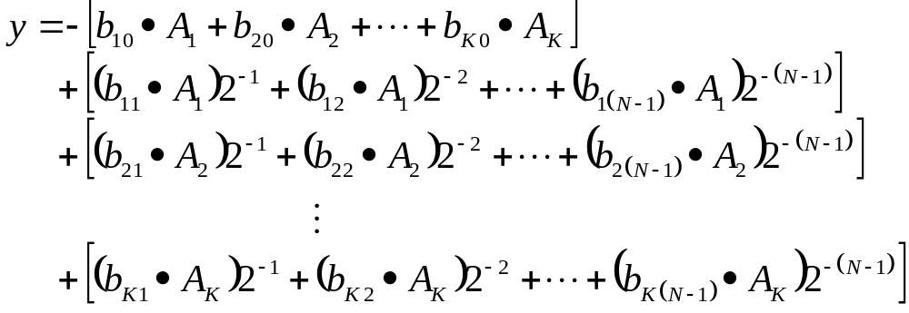
Moving More Closer to DA
…(3)
_{Expanding this part}

Slide 10
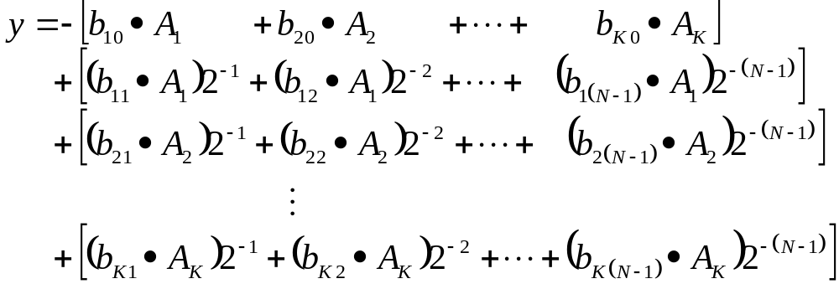
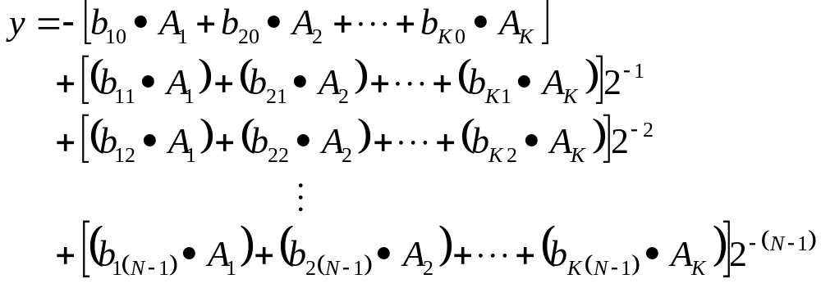
Moving Still More Closer to DA

Slide 11
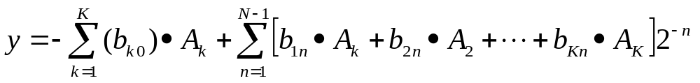
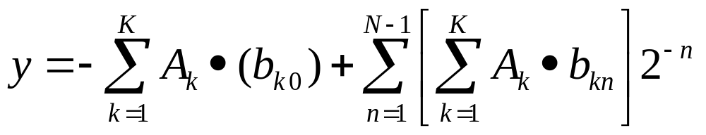
Almost there!
…(4)
_{The Final Reformulation}

Slide 12
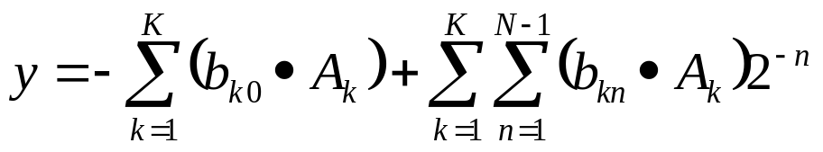
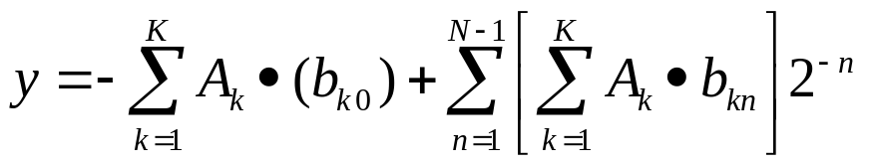
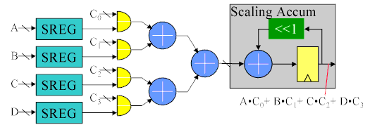
Lets See the change of hardware
_{Our Original Equation}
_{Bit Level Rearrangement}

Slide 13
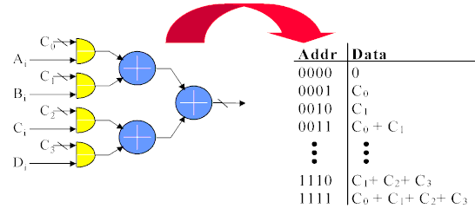
So where does the ROM come in?
Note this portion. It’s can be treated as function of serial inputs bits of
_{{A, B, C,D}}

Slide 14
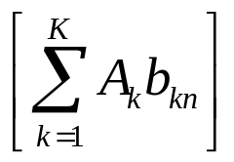
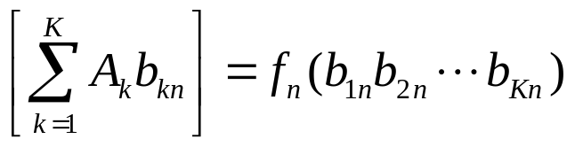
The ROM Construction
has only 2^{K} possible values i.e.
(5) can be pre-calculated for all possible values of b_{1n} b_{2n …}b_{Kn}
We can store these in a look-up table of 2^{K} words addressed by K-bits i.e. b_{1n} b_{2n …}b_{Kn}
…(4)
…(5)

Slide 15
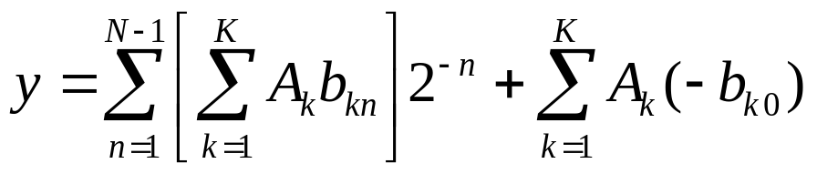
Lets See An Example
Let number of taps K=4
The fixed coefficients are A₁ =0.72, A₂= -0.3, A₃ = 0.95, A₄ = 0.11
We need 2^{K} = 2⁴ = 16-words ROM
…(4)

Slide 16
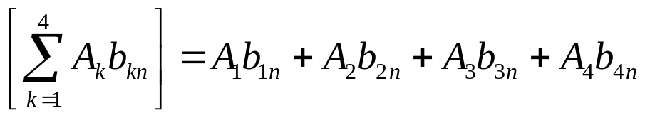
ROM: Address and Contents
b_{1n} | b_{2n} | b_{3n} | b_{4n} | Contents
0 | 0 | 0 | 0 | 0
0 | 0 | 0 | 1 | A₄=0.11
0 | 0 | 1 | 0 | A₃=0.95
0 | 0 | 1 | 1 | A₃+ A₄=1.06
0 | 1 | 0 | 0 | A₂=-0.30
0 | 1 | 0 | 1 | A₂+ A₄= -0.19
0 | 1 | 1 | 0 | A₂+ A₃=0.65
0 | 1 | 1 | 1 | A₂+ A₃ + A₄=0.75
1 | 0 | 0 | 0 | A₁=0.72
1 | 0 | 0 | 1 | A₁+ A₄=0.83
1 | 0 | 1 | 0 | A₁+ A₃=1.67
1 | 0 | 1 | 1 | A₁+ A₃ + A₄=1.78
1 | 1 | 0 | 0 | A₁+ A₂=0.42
1 | 1 | 0 | 1 | A₁+ A₂ + A₄=0.53
1 | 1 | 1 | 0 | A₁+ A₂ + A₃=1.37
1 | 1 | 1 | 1 | A₁+ A₂ + A₃ + A₄=1.48

Slide 17
Key Issue: ROM Size
The size of ROM is very important for high speed implementation as well as area efficiency
ROM size grows exponentially with each added input address line
The number of address lines are equal to the number of elements in the vector i.e. K
Elements up to 16 and more are common => 2¹⁶=64K of ROM!!!
We have to reduce the size of ROM

Slide 18
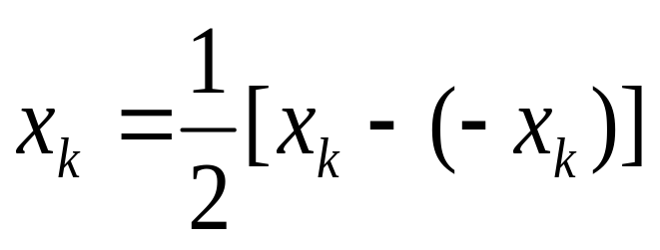
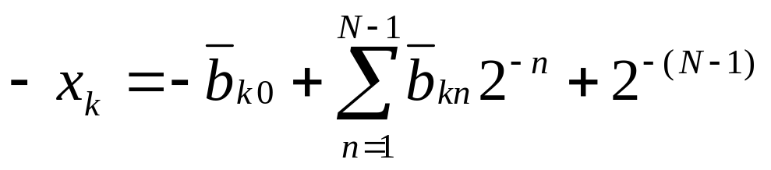
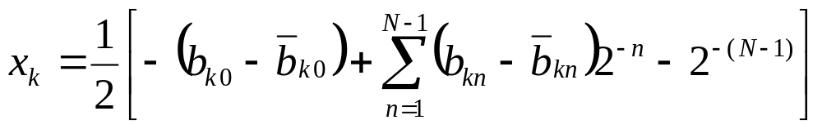
A Very Neat Trick:
…(6)
2‘s-complement
…(7)

Slide 19
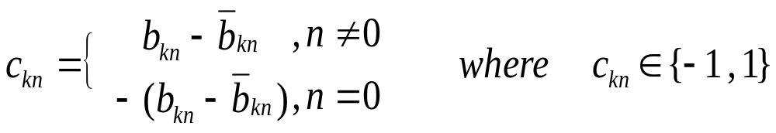
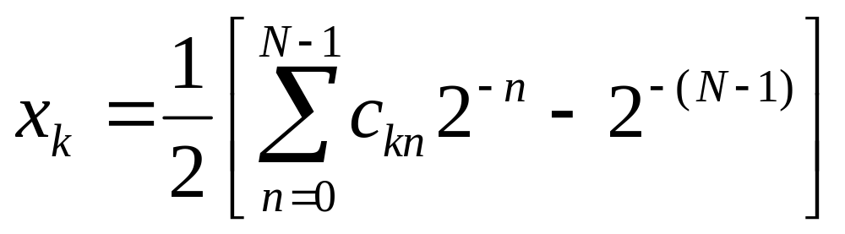
Re-Writing x_{k} in a Different Code
Define: Offset Code
Finally
…(7)
…(8)

Slide 20
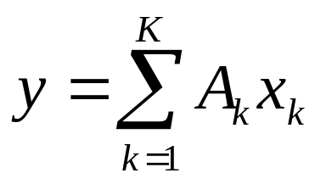
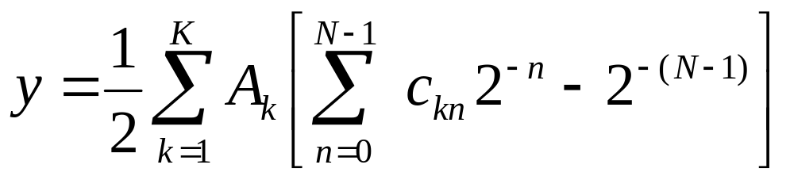
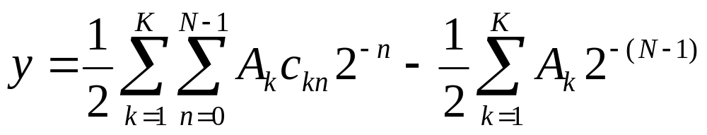
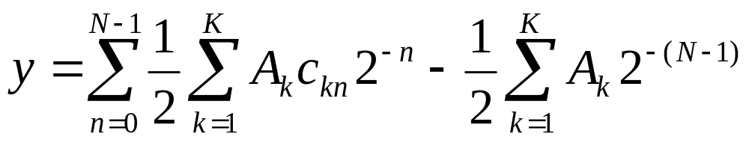
Using the New x_{k}
Substitute the new x_{k} in here
…(9)

Slide 21
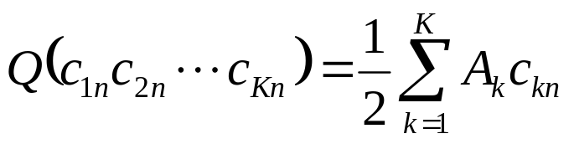
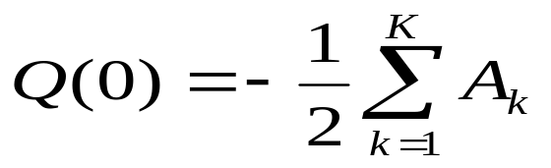
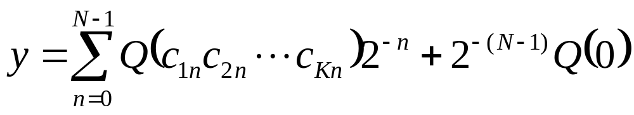
The New Formulation in Offset Code
Let and
Constant

Slide 22
The Benefit: Only Half Values to Store
b_{1n} | b_{2n} | b_{3n} | b_{4n} | c_{1n} | c_{2n} | c_{3n} | c_{4n} | Contents
0 | 0 | 0 | 0 | -1 | -1 | -1 | -1 | -1/2 (A₁+ A₂ + A₃ + A₄) = -0.74
0 | 0 | 0 | 1 | -1 | -1 | -1 | 1 | -1/2 (A₁+ A₂ + A₃ - A₄) = - 0.63
0 | 0 | 1 | 0 | -1 | -1 | 1 | -1 | -1/2 (A₁+ A₂ - A₃ + A₄) = 0.21
0 | 0 | 1 | 1 | -1 | -1 | 1 | 1 | -1/2 (A₁+ A₂ - A₃ - A₄) = 0.32
0 | 1 | 0 | 0 | -1 | 1 | -1 | -1 | -1/2 (A₁ - A₂ + A₃ + A₄) = -1.04
0 | 1 | 0 | 1 | -1 | 1 | -1 | 1 | -1/2 (A₁ - A₂ + A₃ - A₄) = - 0.93
0 | 1 | 1 | 0 | -1 | 1 | 1 | -1 | -1/2 (A₁ - A₂ - A₃ + A₄) = - 0.09
0 | 1 | 1 | 1 | -1 | 1 | 1 | 1 | -1/2 (A₁ - A₂ - A₃ - A₄) = 0.02
1 | 0 | 0 | 0 | 1 | -1 | -1 | -1 | -1/2 (-A₁+ A₂ + A₃ + A₄) = -0.02
1 | 0 | 0 | 1 | 1 | -1 | -1 | 1 | -1/2 (-A₁+ A₂ + A₃ - A₄) = 0.09
1 | 0 | 1 | 0 | 1 | -1 | 1 | -1 | -1/2 (-A₁+ A₂ - A₃ + A₄) = 0.93
1 | 0 | 1 | 1 | 1 | -1 | 1 | 1 | -1/2 (-A₁+ A₂ - A₃ - A₄) = 1.04
1 | 1 | 0 | 0 | 1 | 1 | -1 | -1 | -1/2 (-A₁ - A₂ + A₃ + A₄) = - 0.32
1 | 1 | 0 | 1 | 1 | 1 | -1 | 1 | -1/2 (-A₁ - A₂ + A₃ - A₄) = - 0.21
1 | 1 | 1 | 0 | 1 | 1 | 1 | -1 | -1/2 (-A₁ - A₂ - A₃ + A₄) = 0.63
1 | 1 | 1 | 1 | 1 | 1 | 1 | 1 | -1/2 (-A₁ - A₂ - A₃ - A₄) = 0.74
Inverse symmetry

Slide 23
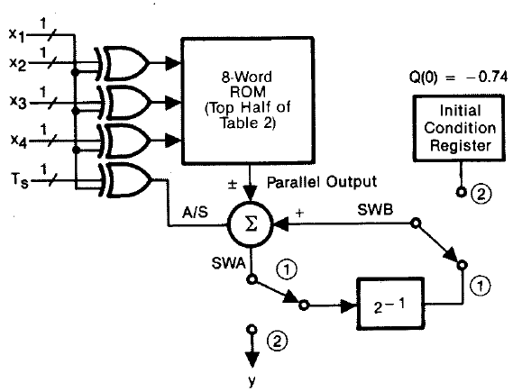
Hardware Using Offset Coding
x₁ selects between the two symmetric halves
T_{s} indicates when the sign bit arrives

Slide 24
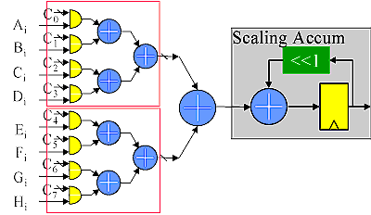
Alternate Technique: Decomposing the ROM
Requires additional adder to the sum the partial outputs

Slide 25
Speed Concerns
We considered One Bit At A Time (1 BAAT)
No. of Clock Cycles Required = N
If K=N, then essentially we are taking 1 cycle per dot product → Not bad!
Opportunity for parallelism exists but at a cost of more hardware
We could have 2 BAAT or up to N BAAT in the extreme case
N BAAT → One complete result/cycle

Slide 26
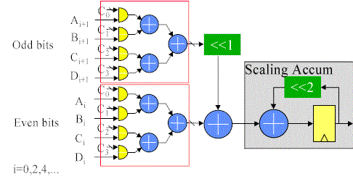
Illustration of 2 BAAT

Slide 27
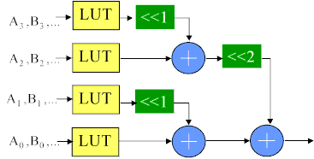
Illustration of N BAAT

Slide 28
The Speed Limit: Carry Propagation
The speed in the critical path is limited by the width of the carry propagation
Speed can be improved upon by using techniques to limit the carry propagation

Slide 29
Speeding Up Further: Using RNS+DA
By Using RNS, the computations can be broken down into smaller elements which can be executed in parallel
Since we are operating on smaller arguments, the carry propagation is naturally limited
So by using RNS+DA, greater speed benefits can be attained, specially for higher precision calculations

Slide 30
Conclusion
Ref: Stanley A. White, “Applications of Distributed Arithmetic to Digital Signal Processing: A Tutorial Review,” IEEE ASSP Magazine, July, 1989
Ref: Xilinx App Note, ”The Role of Distributed Arithmetic In FPGA Based Signal Processing’

